Slide 1
TAX & LICENSE DIVISION
NaN
November 17, 2021 – Navigating City Contracting
Presenters: Linda Weldon, Licensing, Accounting Assistant IV
Nate Malone, Taxes, Budget & Accounting Manager

Slide 2
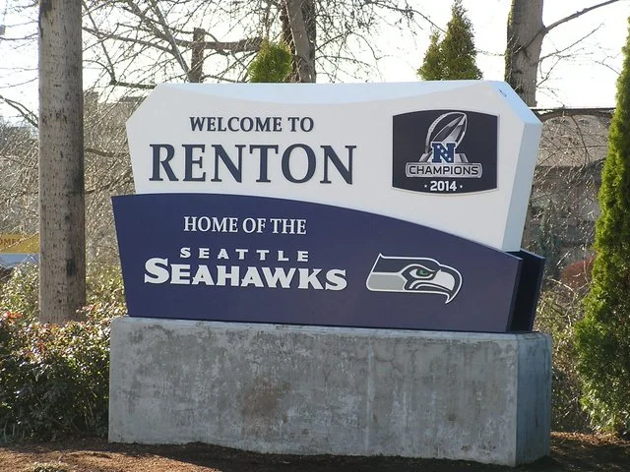
Business License
All businesses operating in the City of Renton are required to obtain a Renton business license.
Business license fee is $150 per year and expires January 31st of each calendar year. The fee is pro-rated to $75.00 if business activity begins after July 1st.
2

Slide 3
Steps to Obtaining a Renton Business License
Obtain a UBI#
www.dor.wa.gov
425-656-5100 or 1-800-647-7706
Apply for a Renton License
License Review Timeframe
In City business – 1-2 weeks after applying
www.filelocal-wa.gov
FileLocal is a third-party portal for applying for a license, renewing a license or filing a tax return
Out of City business – 2-3 days after applying
UBI# is a city requirement
3

Slide 4
Additional License Information
Renton licenses are non-transferrable from owner to owner and location to location (within Renton city limits)
If a business has more than one location within the city, a business license is required for each location
A no-fee license can be obtained if the business meets the following criteria:
No physical location in Renton, No requirement for any other specialized permit or license AND annual Renton revenue of less than $2,000
4

Slide 5
Renton B&O Tax
Businesses are required to file a Renton B&O tax return for each year they hold a Renton license and engage in business in Renton
Threshold for B&O tax is $500,000 in gross receipts before tax is due (filing a return is always required)
New businesses are generally assigned an annual filing frequency
Businesses are required to file with both the State of Washington and with the City of Renton
5

Slide 6
Renton B&O Tax Classifications
Retailing- Retail sales to consumers including construction, repairs, or alterations
Manufacturing/Processing for Hire – Producing a new, different or useful substance or article
Printing / Publishing
Service & Other (Not Apportioned) – personal and professional services or not subject to another classification
Service & Other (Apportioned)- Same as above but in more than one jurisdiction
Retail Services - retail sales for personal, business or professional services (Amusement, physical fitness, rental, ect.)
Wholesaling – Same as retail sales except to persons for resale with resellers permit
6

Slide 7
Other Renton Taxes
Gambling Tax
Admission Tax
Utility Tax
7

Slide 8
How to File Taxes and Renew Licenses
BY MAIL OR DROPBOX
Check
Cashier’s Check
Money Order
IN PERSON
Cash, Credit Card, Check, Cashier’s Check, Money Order
Tax & License In Office Hours
Mon, Tues & Wed
9:00 am to 3:00 pm
ONLINE WWW.FILELOCAL-WA.GOV
ACH
Credit Card
(No Debit Card)
$4.00 Filing Fee
plus
$1.00 ACH Fee or
2.5% Credit Card Fee
Dropbox is located outside Renton City Hall at the end of the sidewalk
8

Slide 9
TAX & LICENSE DIVISION
Questions?
9

